Slide 1
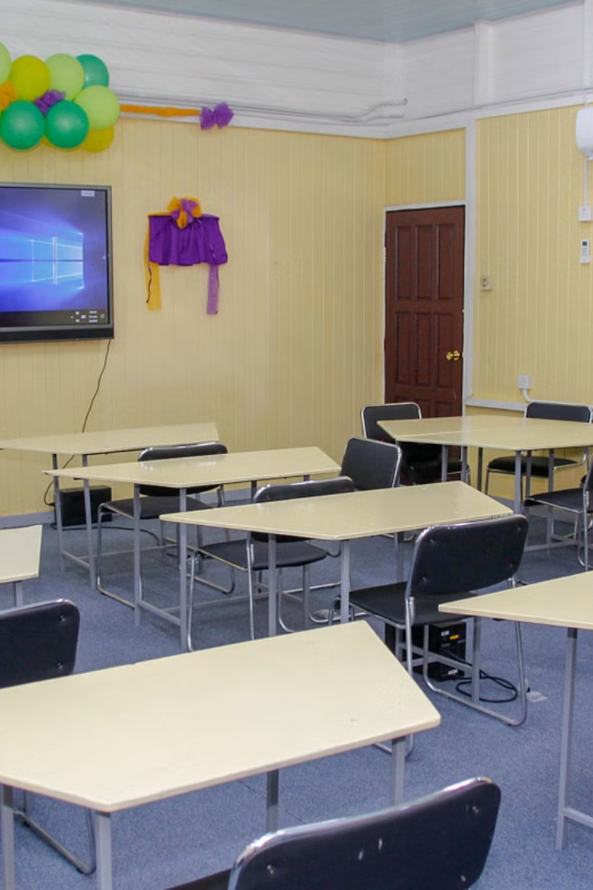
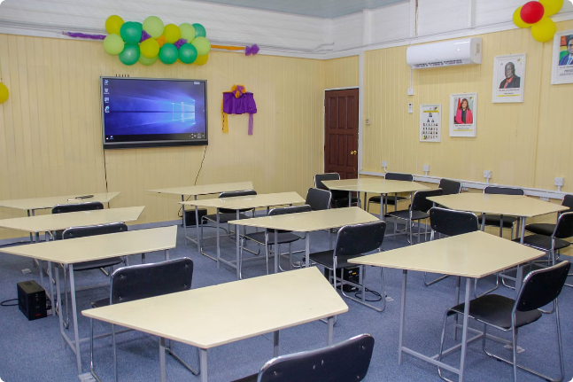
Smart Classroom IoT System Presentation
Welcome to our presentation on the cutting-edge Smart Classroom IoT System. This innovative solution harnesses the power of the Internet of Things (IoT) to create a safer, more comfortable, and interactive learning environment. By seamlessly integrating sensors, devices, and intelligent software, we aim to enhance the educational experience for both students and teachers alike.

Slide 2

System Architecture
1
Central Controller
At the heart of our Smart Classroom lies the powerful ESP32 board, acting as the central controller. This versatile microcontroller manages all devices and sensors, processing data and orchestrating the entire system's operations.
2
Sensor Integration
A network of strategically placed sensors continuously monitors various environmental conditions within the classroom. Temperature and light sensors ensure optimal comfort levels, while gas sensors safeguard against potential hazards like smoke or gas leaks.
3
Intelligent Automation
Leveraging the data collected from sensors, the system automatically adjusts elements such as lighting, temperature, and interactive displays. This intelligent automation not only enhances the learning experience but also promotes energy efficiency and safety.

Slide 3

Hardware Components
Sensors
Output Devices
Temperature Sensor
The OLED display dynamically presents information, alerts, and educational content, enhancing student engagement and interaction. Additionally, energy-efficient LED lights automatically adjust their brightness based on ambient light levels, ensuring optimal lighting conditions.
Light Sensor (LDR)
Gas Sensor (Smoke Detection)
Ultrasonic Sensor
RFID Card Reader
These sensors form the backbone of our system, collecting crucial data about the classroom environment, safety conditions, and occupancy levels.

Slide 4

Software and Connectivity
1
Intelligent Software
2
Wireless Network
Our proprietary software seamlessly integrates all components, managing sensor inputs and controlling output devices. With an intuitive interface, users can monitor real-time data and make adjustments as needed.
A robust wireless network connects all devices, enabling smooth communication and data transfer. The ESP32 board acts as the central hub, ensuring secure and reliable connections.
3
Remote Access
Supporting both Wi-Fi and Bluetooth connectivity, our system allows for remote monitoring and control. This feature enables real-time updates and adjustments, even from off-site locations.

Slide 5



Functional Demonstrations
Temperature Adjustment
Lighting Optimization
Emergency Response
As natural light levels change throughout the day, the light sensor communicates with the LED lights, adjusting their brightness accordingly to maintain optimal illumination while conserving energy.
In the event of a fire or gas leak, the gas sensor immediately detects the hazardous condition, prompting the system to sound alarms, display emergency notifications on the OLED screen, and notify the appropriate authorities.
The temperature sensor detects an increase in classroom temperature, triggering the system to automatically activate the air conditioning unit, ensuring a comfortable learning environment.

Slide 6
Challenges and Solutions
Challenge
Solution
Sensor Integration
Upgraded hardware and refined data handling protocols for better accuracy and reliability.
System Security
Implemented advanced encryption and secure access protocols.
Network Stability
Enhanced network with additional repeaters and optimized software for greater stability.
User-Friendly Interface
Redesigned the interface based on user feedback to improve ease of use.

Slide 7



Results and Impact
Energy Efficiency
Enhanced Safety
Increased Engagement
By optimizing lighting and temperature control, our system has significantly reduced energy consumption, contributing to a more sustainable and eco-friendly learning environment.
With real-time monitoring and automated emergency response capabilities, the Smart Classroom system has greatly improved safety measures, providing peace of mind for students, teachers, and parents alike.
Interactive displays and dynamic content have fostered a more engaging and immersive learning experience, capturing students' attention and promoting better retention of information.

Slide 8
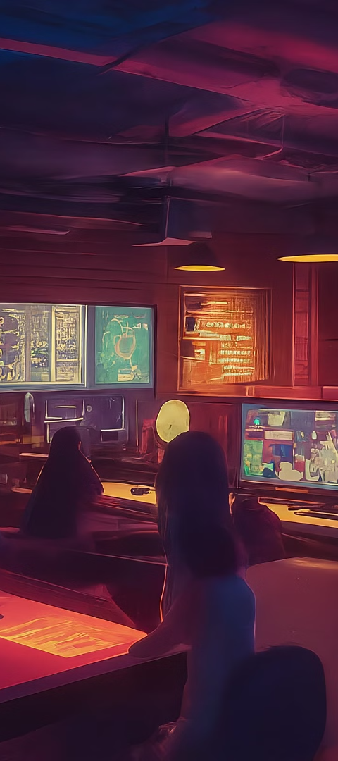
Future Directions
System Expansion
Advanced Features
We plan to expand the Smart Classroom system to more classrooms and buildings, ultimately aiming for campus-wide integration, ensuring a consistent and enhanced learning experience across all educational facilities.
Incorporating artificial intelligence (AI) capabilities will enable the system to learn and adapt, further optimizing environmental settings based on real-time data. Additionally, we aim to include new sensors, such as air quality monitors, to enhance classroom safety and comfort.
Software Upgrades
Continuous software improvements are planned, including advanced analytics for better insights into classroom dynamics and efficiency, as well as user interface enhancements for easier navigation and control.

